Slide 1
WHAT IS A STORY?
“A literate human being can look at a sequence of letters and spaces [and colours, sounds, lines, dots, etc.] and decide whether it constitutes a story; they know how to ‘read’ the code and work out its meaning, if it’s a language they understand.
They can make a stab at deciding whether it’s a good story or not. However, we do not know how to transfer this ability to a computer. The rules that our minds use to decide whether what we’re reading is a story are implicit in the networks of nerve cells in our brains.
Nobody has yet been able to make these rules explicit.” [Cohen, Pratchett, Stewart]
Notes:
One final note about story definitions – stories really are hard to define!

Slide 2
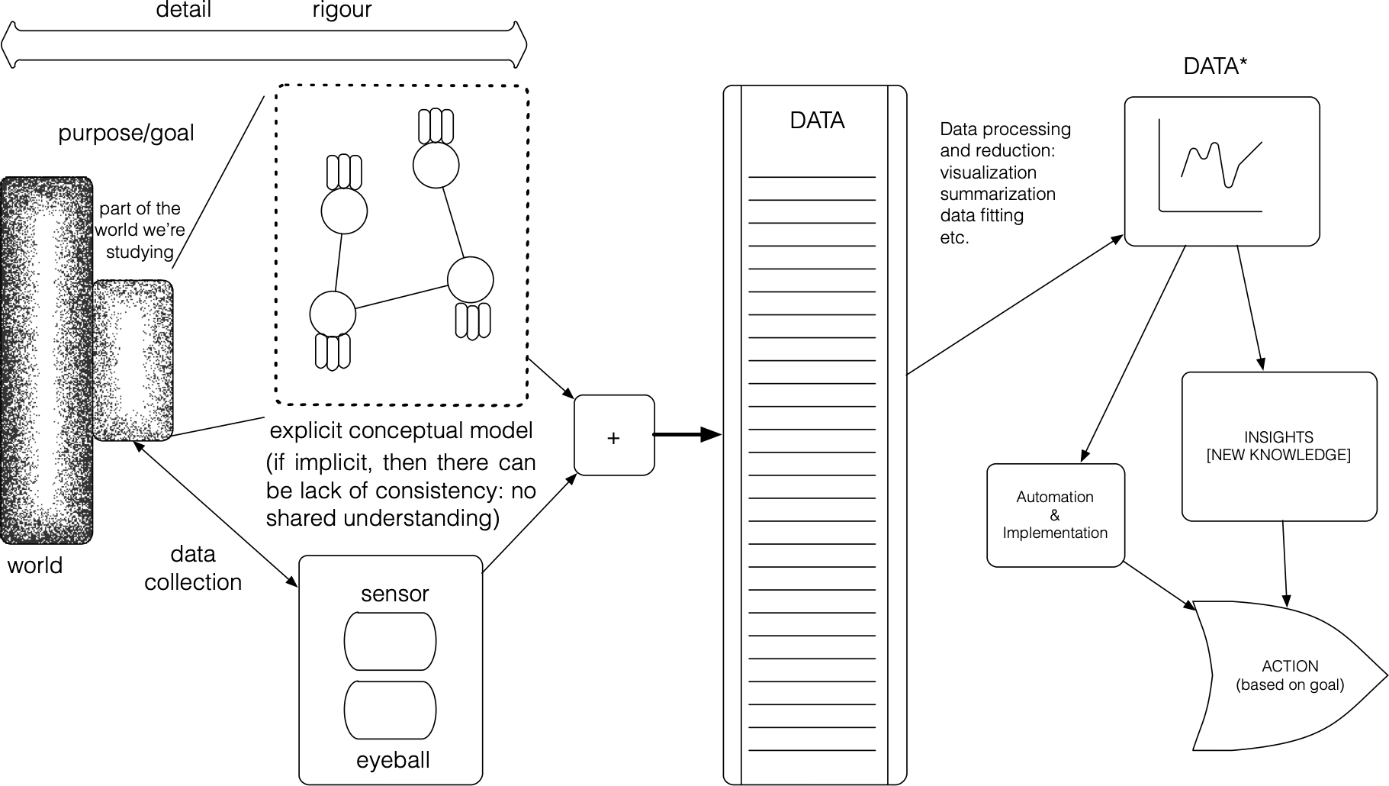
JEN’s SYSTEM SLIDE
Jen’s system slide
Notes:
Figure 4.4: A schematic diagram of systems thinking as it applies to a general problem: as we move from the concrete world (left; details) to abstractions (right, rigour), our understanding gets ‘storified’ [61].
Abstraction (lies-to-children) require choices; these choices are informed by the storytelling context and the storytellers – we will revisit this in Elements of Storytelling.
This is part of a more general problem that humans have with stories, perhaps best exemplified by the concept of the lie-to-children:
“A lie-to-children is a statement that is false, but which nevertheless leads the child’s mind towards a more accurate explanation, one that the child will only be able to appreciate if it has been primed with a lie. The early stages of education have to include a lot of lies-to-children, because early explanations have to be simple. However, we live in a complex world, and lies-to-children must eventually be replaced by more complex stories if they are not to become delayed-action genuine lies.” [51]
Simply put, we are very simple creatures living in a very complicated world: we may attempt to explain the Universe with “lies-to-children”, but that does not mean that the Universe ultimately has to comply with our stories.

Slide 3
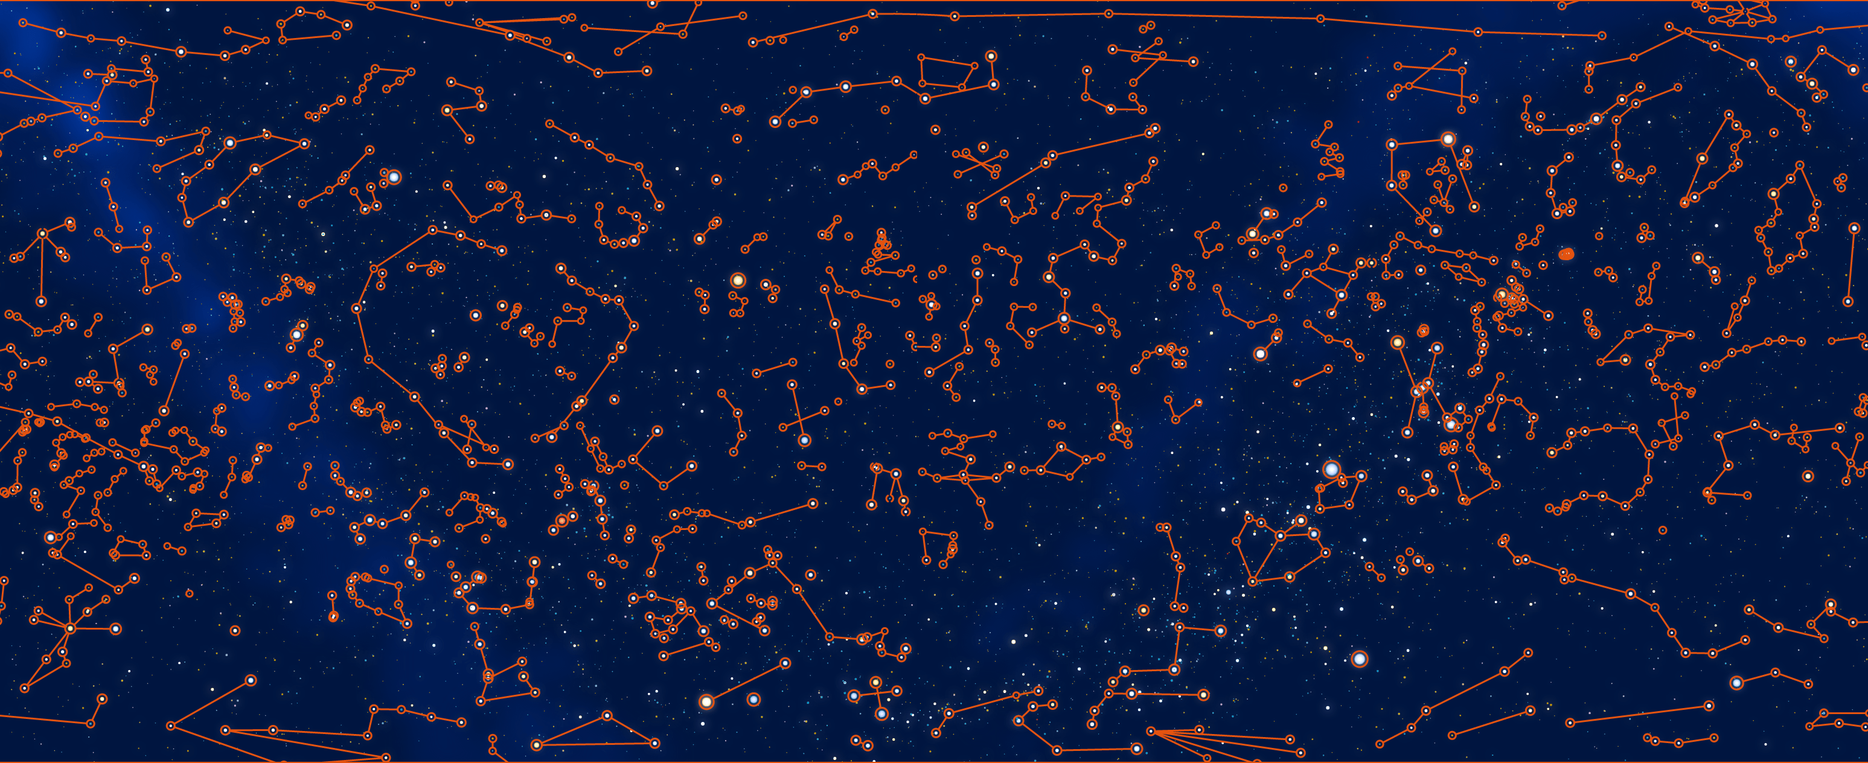
A SKY FULL OF STARS – CHINESE CONSTELLATIONS
[figuresinthesky.visualcinnamon.com]
We have always had a drive to paint stories onto the Universe. When humans first looked at stars, which are great flaming suns an unimaginable distance away, they saw amongst them giant bulls, dragons, and local heroes. Humans think in stories. [Cohen, Pratchett, Stewart]
Notes:
t is one and only one story for Mr. Greenway and the Low Down: it was only written (and published) once, for all the world to see. But it was not the same story for different audiences. Context matters.
“To some, this might smack of post-modernism:”you are saying that there is no truth, and that data analysis is pointless!” To which our response is: “analysts have agency (lots of it, as it turns out), and their choices DO influence the results… so run multiple analyses to determine the variability of the outcomes”. That is simply the nature of the discipline.” [61]
The same goes for stories and data stories: multiplicity helps get a better idea of exactly what is going on (definitely in the preparation stage, at least!).
As an illustration, let us re-visit the constellation example of Figure 4.1. You will not be surprised to find out that different culture had different night skies: of course, the skies themselves were the same (give or take a few stars based on a culture’s location on Earth), but they were definitely viewed differently, based on the various myths.

Slide 4
“We are ambivalent […] about beginnings – their ‘creation myth’ aspect appeals to our sense of narrative imperative, but we sometimes find that the ‘first it wasn’t, then it was’ lie-to-children unpalatable.
We have even more trouble with becomings. Our minds attach labels to things in the surrounding world, and we interpret those labels as discontinuities. If things have different labels, then we expect there to be a clean line of demarcation between them.
The Universe, however, runs on processes rather than things, and a process starts as one thing and becomes another without ever crossing a clear boundary.
Worst, if there is some apparent boundary, we are likely to point at it and shout ‘that’s it!’ just because we can’t see anything else worth getting agitated about.”
[Cohen, Pratchett, Stewart]

Slide 5

THE CLOWNFISH AND THE DEVILFISH
There once was a fish named Marlin, who loved his son Nemo more than anything. Every day he tried to protect Nemo from the ocean, which he feared.
When he died, his father looked into the vast, terrible sea and he could not find him.
Then a great monster, the Devilfish, saw Marlin's mourning face and he cackled, “You’re mine!“ Suddenly, the devilfish attacked Marlin, dragging him to his death, and Marlin has never looked back.
Notes:
Sometimes, narratives have the trappings of stories without actually being stories. Consider, for instance, the following text:
“There once was a fish named Marlin, who loved his son Nemo more than anything. Every day he tried to protect Nemo from the ocean, which he feared. When he died, his father looked into the vast, terrible sea and he could not find him. Then a great monster, the Devilfish, saw Marlin’s mourning face and he cackled,”You’re mine!” Suddenly, the devilfish attacked Marlin, dragging him to his death, and Marlin has never looked back.”
This reads, looks, and feels like a story, but we do not think it a story, at least, not a one with memetic power.
Consider instead the following tale, titled 30 Years,³⁷:
“A fellow went to a Zen master and said,”If I work very hard, how soon can I be enlightened?” The Zen master looked him up and down and said, “Ten years.” The fellow said, “No, listen, I mean if I really work at it, how long –” The Zen master cut him off. “I’m sorry. I misjudged. Twenty years.” “Wait!” said the young man, “You don’t understand! I’m –” “Thirty years,” said the Zen master.”
It is clearly memetic, having been passed along among certain modern adepts of Zen Buddhism (ultimately finding its way in these pages); while it appears Zen koan-like to non-expert eyes, we wonder if it is not simply a joke. Jokes can be stories, of course, and a story’s meaning is not always apparent (or in the case of Zen koans, even a requisite quality), but this one seems too vague to qualify as a story in our books. What do you think?

Slide 6
WHAT IS NOT A STORY?
Sometimes it’s easier to get a sense of what something is by looking at examples of what it is not!
Edge cases are helpful too…
Notes:
SLIDE ADDED BY JEN

Slide 7
WHAT IS NOT A STORY?
That’s not easy to determine. Is a list a story?
Is a theorem?
A newspaper heading?
A joke?
A chart?
Notes:
JEN – MOVED THIS SLIDE
For grocery lists, the classification is straightforward;³⁴ but in general, there could be complications. Is a theorem a story? A newspaper heading? A joke? A chart?

Slide 8
SIDE NOTE: What’s THE Story?
A note about the phrase “What’s the story?”
We often use this as a short-hand for asking:
What’s the conclusion of the story?
What’s the current situation? Or the explanation for the current situation.
Not necessarily the same as “What’s the whole story?”
Notes:
JEN ADDED SLIDE

Slide 9
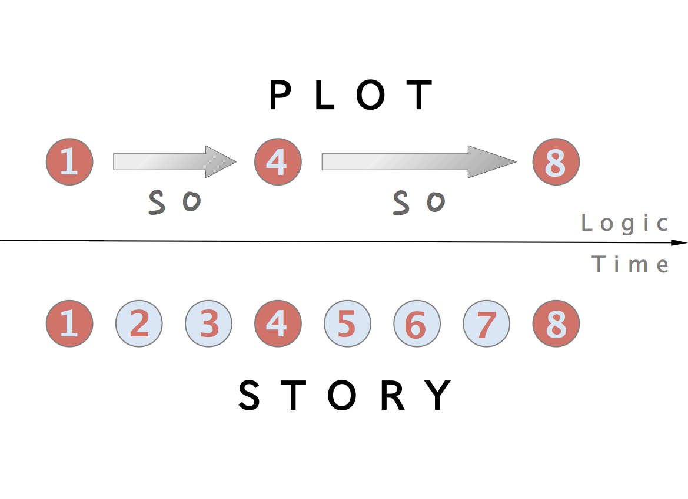
PLOT VS. STORY
[まとりょーしか]
A story’s plot is the essential sequence of its elements.
The plot lives in logical space, the story in sequential space.
Notes:
For grocery lists, the classification is straightforward;³⁴ but in general, there could be complications. Is a theorem a story? A newspaper heading? A joke? A chart?
One distinction that is sometimes made is that between a story and its plot. A story’s plot is the essential sequence of its elements, the skeleton of the story: the blurb presented at the start of this module is Finding Nemo’s plot. The plot typically resides in logical space (if this happens, then that will happen, and so this final thing will also happen), whereas the story live in sequential space (a number of related events are presented sequentially, although they could be shown out of order) [まとりょーしか]:
We are of two minds about that: reading this overview of the Marvel Cinematic Universe’s Infinity Saga³⁵ is emphatically not the same thing as getting the full story from the 23 movies (and assorted TV shows, one-offs, and comic books), but … well, it still provides something that is story-adjacent to it. While stories are more than just their plots³⁶, maybe plots can still function as bare stories.

Slide 10
NARRATIVE STRUCTURE FOR DATA STORIES
In practice, these narrative structures might not easily apply to data stories.
The take-away here is that if a chart element (a “dot” in the narrative paths) can be removed without changing the nature of the data story, then the chart element was not needed in the first place and should be removed.

Slide 11
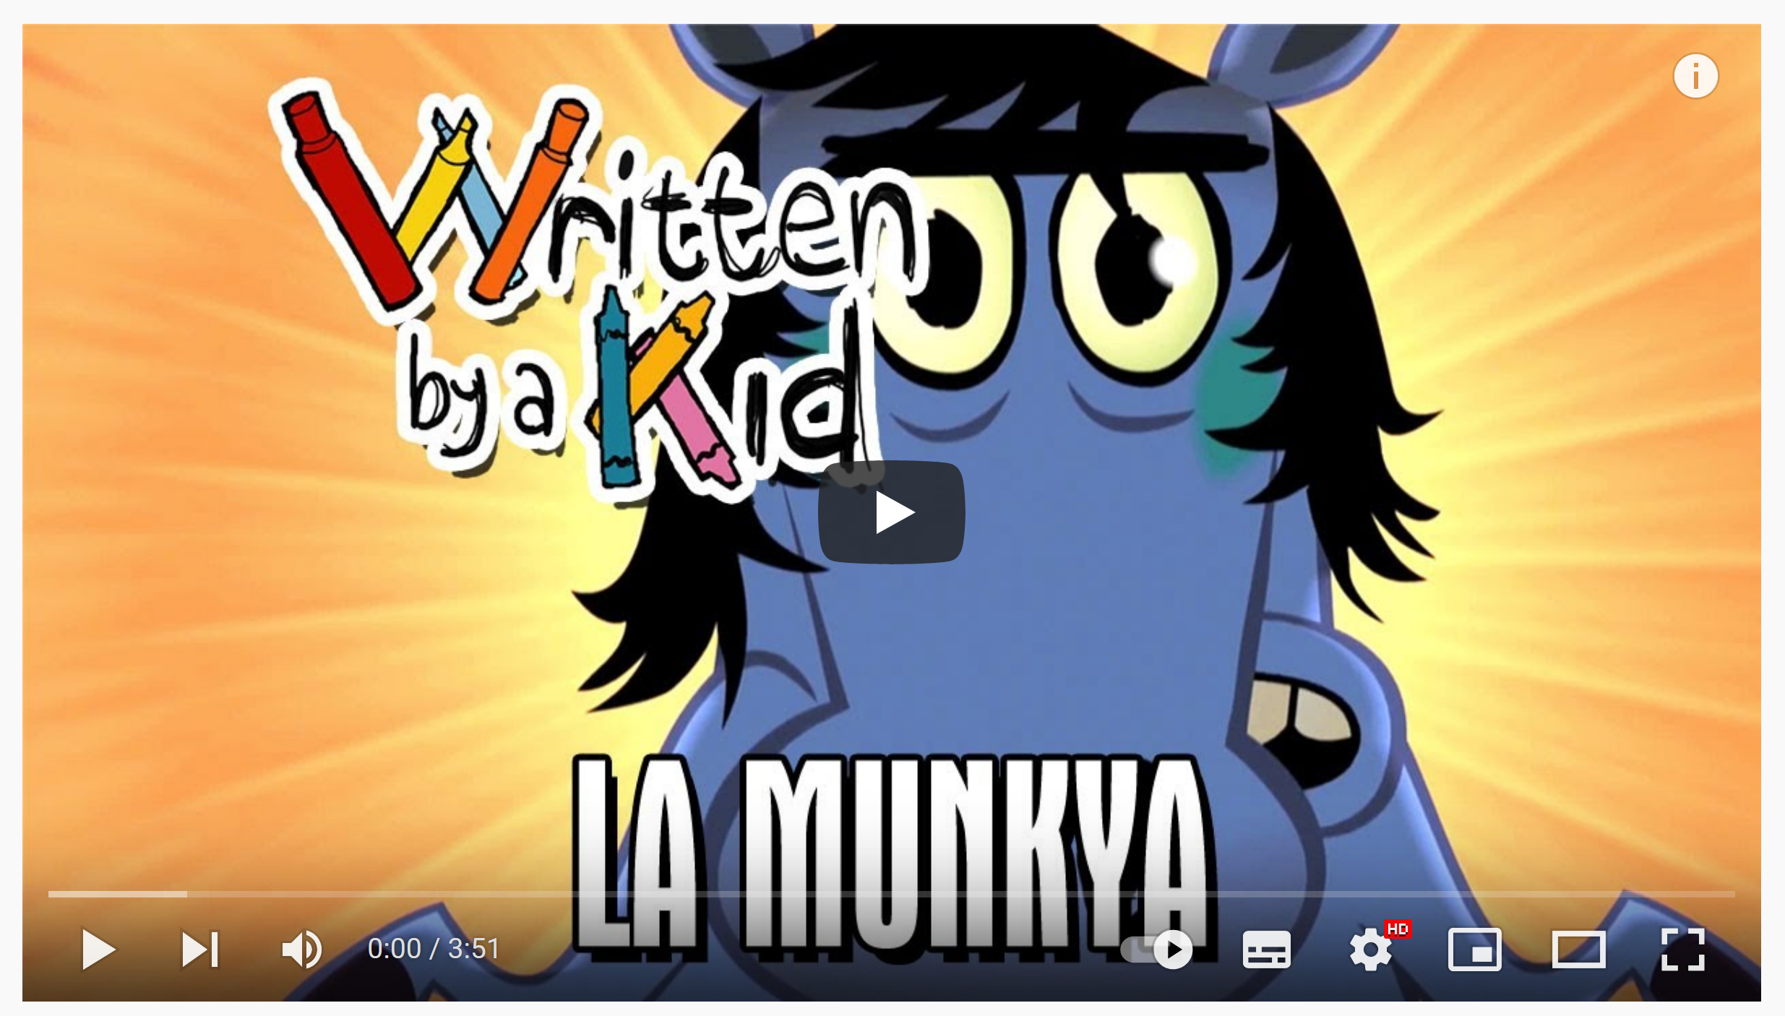
LA MUNKYA
[https://www.youtube.com/watch?v=O_UWRUacIuk]
Notes:
What about La Munkya, the absurdly adorable “Written by a Kid” video featuring a paper panty-clad horse, a jailbreak, and turtles?
Although La Munkya does not qualify as story in our view, Emily is a superb storyteller: she almost carries the meandering narrative to the promised land on the strength of her confident voice and commanding presence alone.

Slide 12
30 YEARS
A fellow went to a Zen master and said, “If I work very hard, how soon can I be enlightened?”
The Zen master looked him up and down and said, “Ten years.”
The fellow said, “No, listen, I mean if I really work at it, how long—”
The Zen master cut him off. “I’m sorry. I misjudged. Twenty years.”
”Wait!” Said the young man, “You don’t understand! I’m—”
“Thirty years,” said the Zen master.
Notes:
Consider instead the following tale, titled 30 Years,³⁷:
“A fellow went to a Zen master and said,”If I work very hard, how soon can I be enlightened?” The Zen master looked him up and down and said, “Ten years.” The fellow said, “No, listen, I mean if I really work at it, how long –” The Zen master cut him off. “I’m sorry. I misjudged. Twenty years.” “Wait!” said the young man, “You don’t understand! I’m –” “Thirty years,” said the Zen master.”
It is clearly memetic, having been passed along among certain modern adepts of Zen Buddhism (ultimately finding its way in these pages); while it appears Zen koan-like to non-expert eyes, we wonder if it is not simply a joke. Jokes can be stories, of course, and a story’s meaning is not always apparent (or in the case of Zen koans, even a requisite quality), but this one seems too vague to qualify as a story in our books. What do you think?

Slide 13
EXERCISE: IS THIS A STORY?
Two identical infants lay in a cradle. “One you bore, the other is a Changeling. Choose wisely,” the Fae’s voice echoed from the shadow. “I’m taking both my children,” the mother said defiantly.
Solomon was required to decide which of two women was the mother of a baby, when each of them claimed parenthood. Both had recently given birth, but one child had died. Solomon announced that the child should be cut in two, so that each mother should have half. The real mother, unable to bear her son being killed, immediately offered it to the other woman, to save the child's life, whereas the other agreed to the proposal. The false mother was thus exposed, and Solomon returned the living child to its real mother.

Slide 14
EXERCISE: IS THIS A STORY?
For sale: baby shoes. Never worn.
Doctors think that they may have improved the diagnosis of liver disease by 1%.
Scientists claims cure for cancer.
Spiritualist medium claims cure for cancer.
Sens rally after blowing lead; beat Leafs to gain on Habs.
Macbeth and his wife Want to become the royals So they kill 'em all.

Slide 15
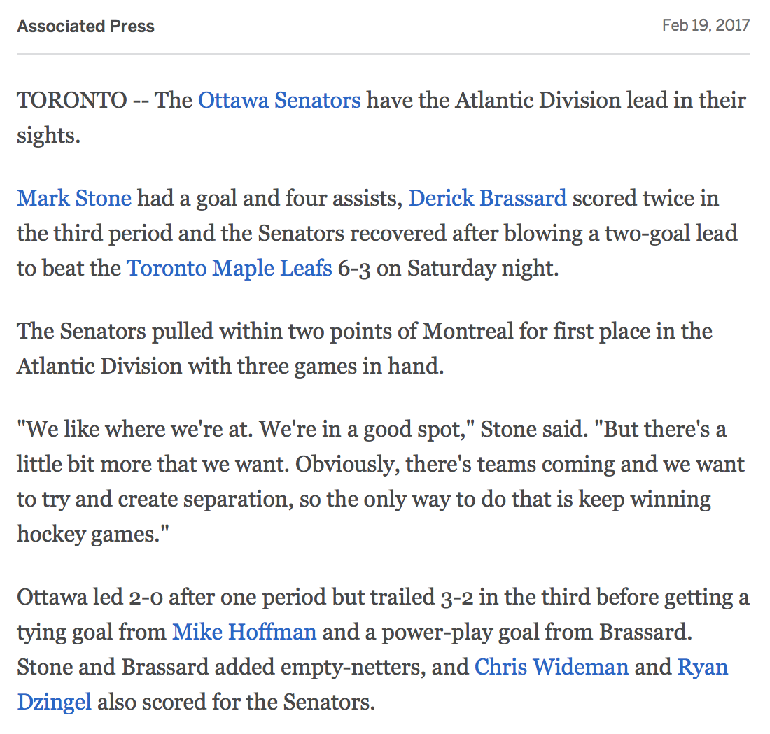
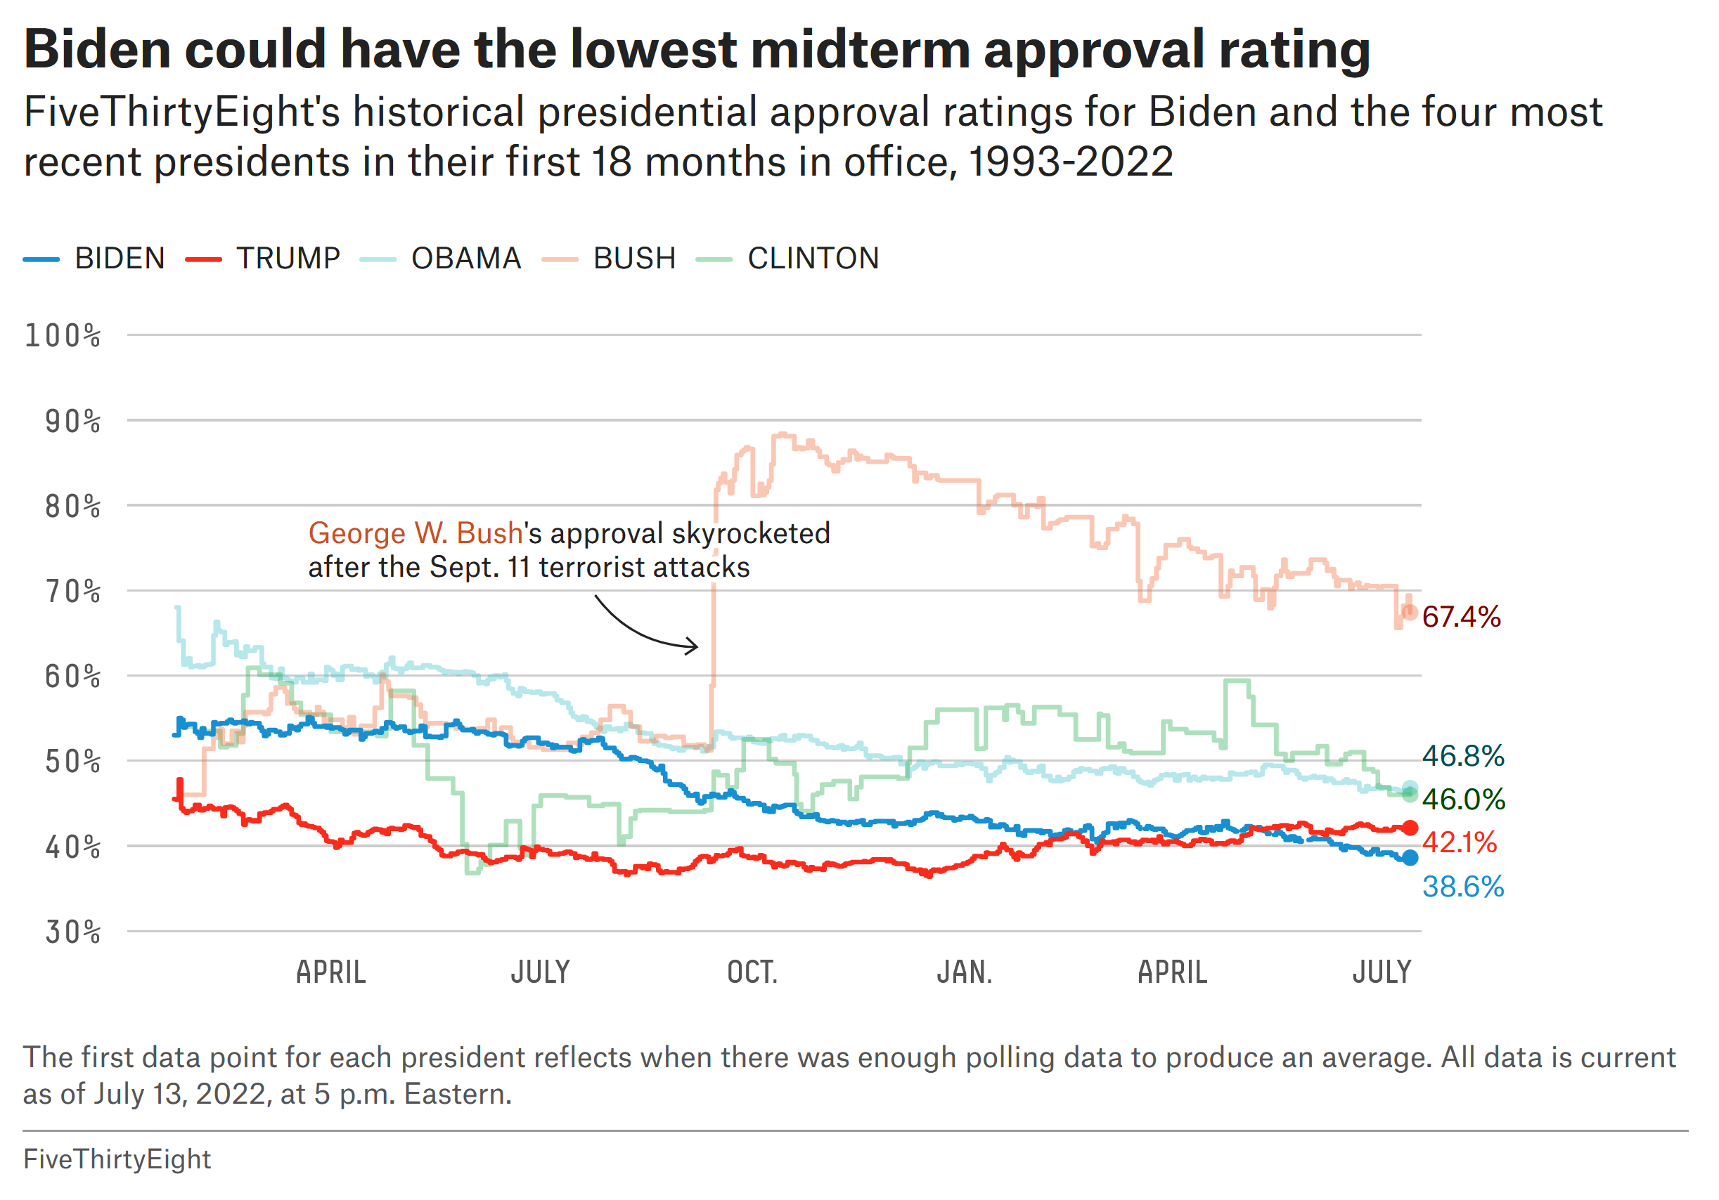
EXERCISE: IS THIS A STORY?

Slide 16
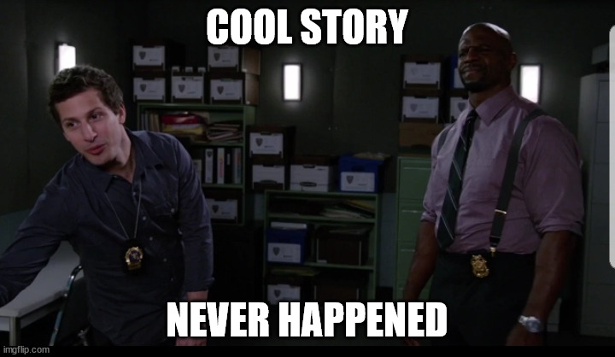
PHANTOM TIME HYPOTHESIS
[P. Dodds]
What: the years 614–911 AD never existed, so the year 2017 AD is really 1820 AD!
How: straight up jump of 297 years done by a 1st millennium cabal!
Why: HRE Otto III, Pope Sylvester II wanted to live in 1000 AD in order to legitimize power!
But: records of solar eclipses, comets, tree rings
Notes:
Peter Dodds [62] also reminds us that real stories are never told in their entirety: it is impossible to record every detail of an ideal (Platonic) story, as recording entails compression to medium format and scale (narrative hierarchy). Storytelling converges to the story logic, while seemingly irrelevant aspects (which remain part of the story) are discarded in favour of aspects which are likely to carry more weight with the audience.
These adjacent stories (of which there can be infinitely many, at least in theory) afford “better” stories, which is to say, stories that are:
more engaging;
more motivating to spread (more memetic), and
more durable (robust) under spreading.
These “better” stories are used by “true-to-life” recorders and re-tellers (such as journalists) to reach larger audiences, but the infinitude of adjacent stories also means that “better” stories are used for disinformation: adjacent stories may be low on truth and bear falsehoods. When adjacent stories conform to a groups’ world view and ideology, they tend to spread like wildfire (or more accurately, like a virus); this is not surprising, since even non-adjacent stories must be coherent and at least possible.³⁹
Example (also from [62]): the Phantom Time Hypothesis, by German pseudohistorian Heribert Illig, illustrates the seductive power of adjacent stories. The long and the short of it is that the the years AD (CE) 614-911 never existed, and so that the year AD (CE) 2022 should really be labeled AD (CE) 1825. Supposedly, a 1st millenium cabal consisting of “the Holy Roman Emperor Otto III, Pope Sylvester II (and possibly the Byzantine Emperor Constantine VII) fabricated the Anno Domini dating system retroactively, in order to place themselves at the special year of AD 1000, and to rewrite history to legitimize Otto’s claim to the Holy Roman Empire.”
It is a powerful story, and it concords with some of our prejudices: we think that most of us could easily conceive of a Holy Roman Emperor, a Byzantine emperor (possibly), and a Pope thirsting for power, and scheming behind the scenes to find ways to stay in power as long as they live; it even touches on our love of numerology!
Illig also brings forward evidence to support his claim (in case the story itself should prove insufficient to persuade a world determined to stay in the dark!); the nature of the evidence is such that it is easily refuted by records of solar eclipses and comet appearances over the years, as well as dendrochronology (the study of tree rings). By proposing an alternative to “establishment” history (the null hypothesis), phantom time hypothesists hold the burden of proof: if their evidence does not support their claim, it should at the very least not support the chronology they are trying to overthrow.

Slide 17
ADJACENT STORIES (Peter Dodds)
Storytelling converges to story logic: irrelevant aspects are discarded in favour of aspects which are likely to carry more weight.
Adjacent stories (of which there can be infinitely many, at least in theory) afford “better” stories, which is to say, stories that are:
more engaging;
more motivating to spread (more memetic), and
more durable (robust) under spreading.
Notes:
Peter Dodds [62] also reminds us that real stories are never told in their entirety: it is impossible to record every detail of an ideal (Platonic) story, as recording entails compression to medium format and scale (narrative hierarchy). Storytelling converges to the story logic, while seemingly irrelevant aspects (which remain part of the story) are discarded in favour of aspects which are likely to carry more weight with the audience.
These adjacent stories (of which there can be infinitely many, at least in theory) afford “better” stories, which is to say, stories that are:
more engaging;
more motivating to spread (more memetic), and
more durable (robust) under spreading.
These “better” stories are used by “true-to-life” recorders and re-tellers (such as journalists) to reach larger audiences, but the infinitude of adjacent stories also means that “better” stories are used for disinformation: adjacent stories may be low on truth and bear falsehoods. When adjacent stories conform to a groups’ world view and ideology, they tend to spread like wildfire (or more accurately, like a virus); this is not surprising, since even non-adjacent stories must be coherent and at least possible.³

Slide 18

[https://www.lowdownonline.com/post/wakefield-nurse-fires-up-freedom-convoy]
What might lead one to view the subject of this article in a positive light?
A negative light? A neutral light?
What might lead one to view the author of this article in a positive light?
A negative light? A neutral light?
Notes:
The same story may thus have different outcomes/impacts in different contexts. Consider, for instance, Trevor Greenway’s article Wakefield nurse fires up Freedom Convoy published in The Low Down to Hull and Back on Feb 9, 2022.⁴⁵
Based only on the headline, the photo, and the accompanying blurb, what is your opinion on the subject (the nurse)? The author? Read the article: have your opinions changed?
This was one of the Low Down’s most “controversial” articles ever. Some calls and letters to the Editor excoriated the newspaper for painting an “anti-vaxxer” in a sympathetic light, others for ridiculing a hard-working and honest citizens.
It is one and only one story for Mr. Greenway and the Low Down: it was only written (and published) once, for all the world to see. But it was not the same story for different audiences. Context matters.
“To some, this might smack of post-modernism:”you are saying that there is no truth, and that data analysis is pointless!” To which our response is: “analysts have agency (lots of it, as it turns out), and their choices DO influence the results… so run multiple analyses to determine the variability of the outcomes”. That is simply the nature of the discipline.” [61]
The same goes for stories and data stories: multiplicity helps get a better idea of exactly what is going on (definitely in the preparation stage, at least!).

Slide 19
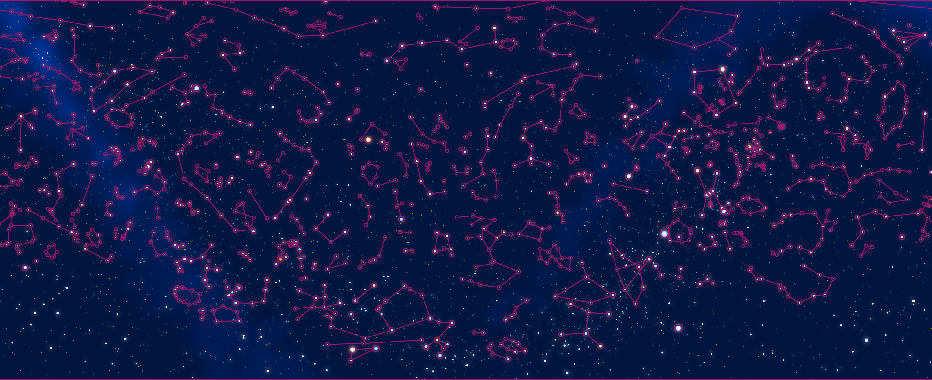
A SKY FULL OF STARS – KOREAN CONSTELLATIONS
[figuresinthesky.visualcinnamon.com]
We have always had a drive to paint stories onto the Universe. When humans first looked at stars, which are great flaming suns an unimaginable distance away, they saw amongst them giant bulls, dragons, and local heroes. Humans think in stories. [Cohen, Pratchett, Stewart]
Notes:
As an illustration, let us re-visit the constellation example of Figure 4.1. You will not be surprised to find out that different culture had different night skies: of course, the skies themselves were the same (give or take a few stars based on a culture’s location on Earth), but they were definitely viewed differently, based on the various myths.

Slide 20
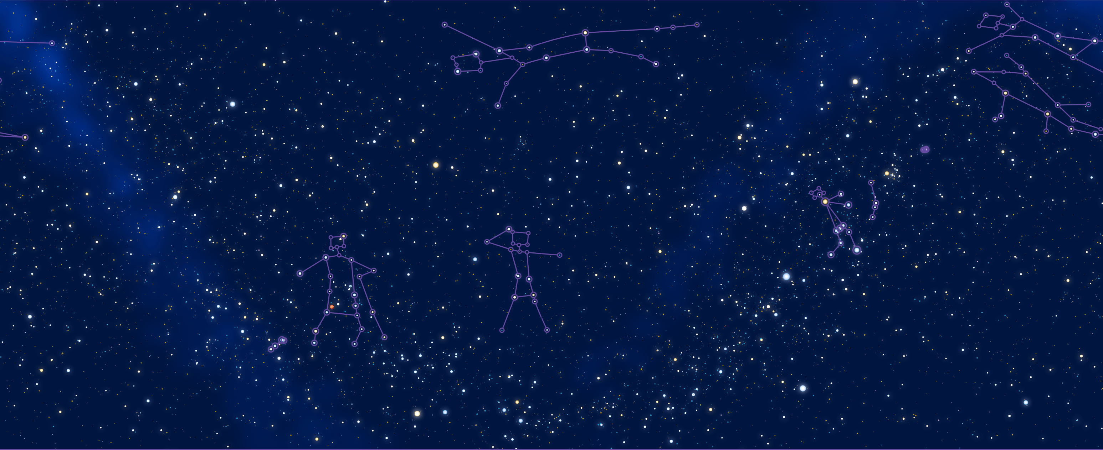
A SKY FULL OF STARS – (SOME) NAVAJO CONSTELLATIONS
[figuresinthesky.visualcinnamon.com]
We have always had a drive to paint stories onto the Universe. When humans first looked at stars, which are great flaming suns an unimaginable distance away, they saw amongst them giant bulls, dragons, and local heroes. Humans think in stories. [Cohen, Pratchett, Stewart]
Notes:
There are marked differences:
Chinese constellations are much more numerous (and so smaller) than the modern IAU constellations;
there are very few southern Korean constellations (presumably due to the northern location of Korea);
the Navajo constellations that are presented are more easily recognizable as human figures than they are in the other systems;
the Maori constellations are nautically themed (fishing hook, etc.).
Upon reflection it is not too surprising that all these cultures had different constellations, and that all of them are as “true” as one another, but it is somewhat surprising that all cultures have constellations… Might this be the actual story?
This is an unspoken challenge of storytelling – the audience may fail to agree that the story is what the author think it is: the “author is dead” [77] (at least, up to a point). Stories are universally appealing to humans, but their interpretations are no universal.

Slide 21
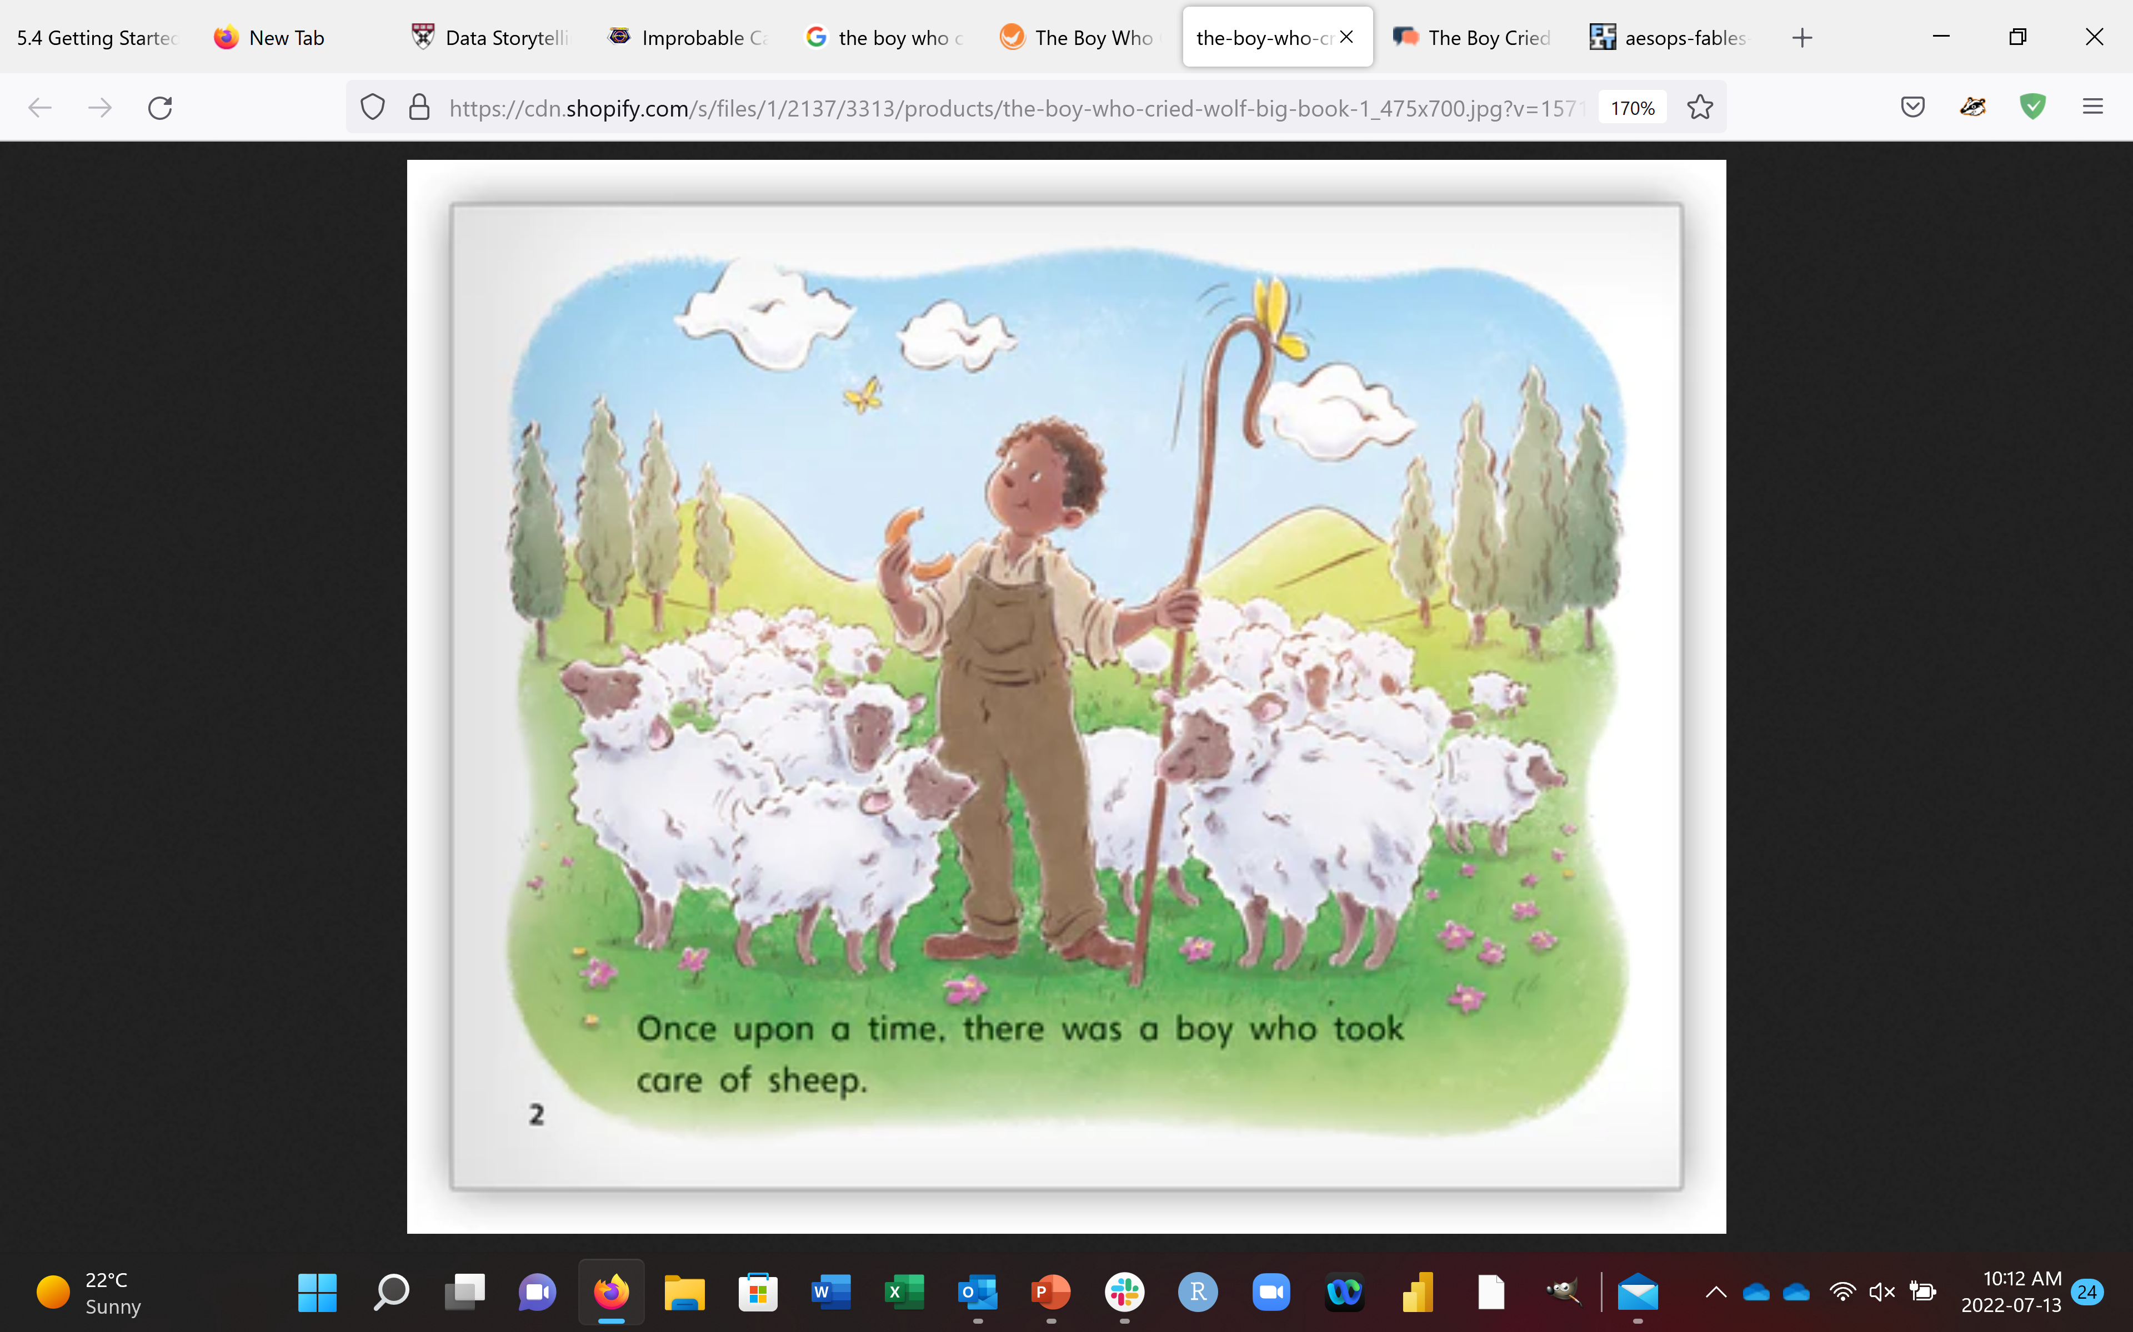
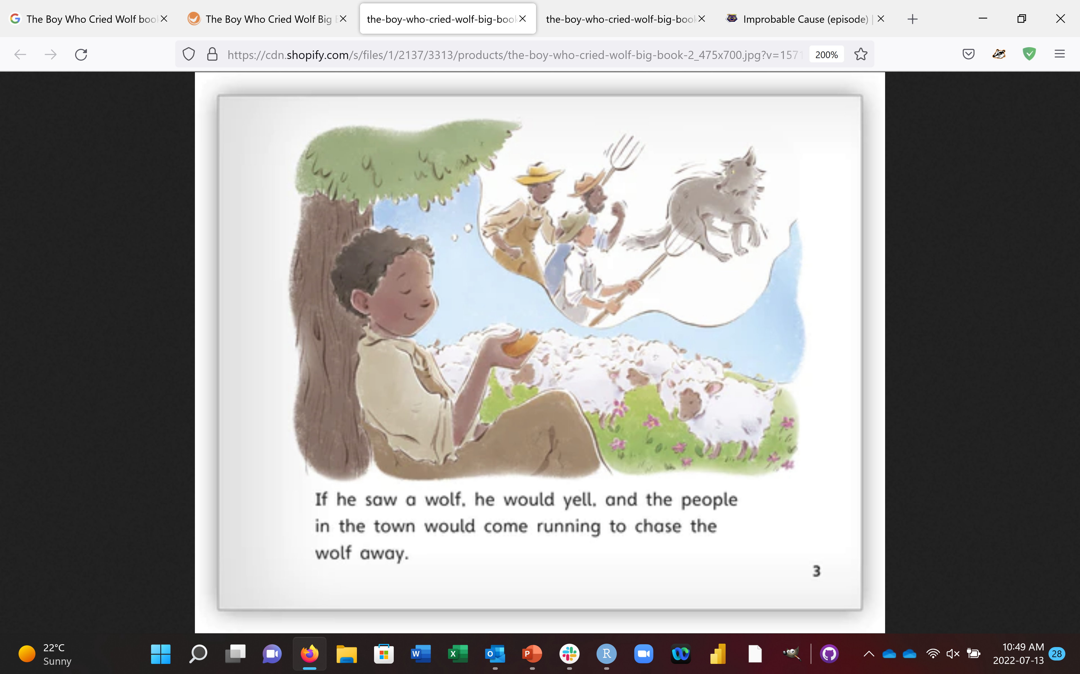
STORYTELLING UNIVERSALITY
[Illustrations: V. Jaskina]
There once was a shepherd boy who was bored as he sat on the hillside watching the village sheep. To amuse himself he took a great breath and sang out, "Wolf! Wolf! The Wolf is chasing the sheep!"
The villagers came running up the hill to help the boy drive the wolf away. But when they arrived at the top of the hill, they found no wolf. The boy laughed at the sight of their angry faces. "Don't cry 'wolf', shepherd boy," said the villagers, "when there's no wolf!" They went grumbling back down the hill.
Later, the boy sang out again, "Wolf! Wolf! The wolf is chasing the sheep!" To his naughty delight, he watched the villagers run up the hill to help him drive the wolf away.
When the villagers saw no wolf they sternly said, "Save your frightened song for when there is really something wrong! Don't cry 'wolf' when there is NO wolf!"
Notes:
Consider the old Aesop fable:
The Boy Who Cried Wolf There once was a shepherd boy who was bored as he sat on the hillside watching the village sheep. To amuse himself he took a great breath and sang out, “Wolf! Wolf! The Wolf is chasing the sheep!” The villagers came running up the hill to help the boy drive the wolf away. But when they arrived at the top of the hill, they found no wolf. The boy laughed at the sight of their angry faces. “Don’t cry ‘wolf’, shepherd boy,” said the villagers, “when there’s no wolf!” They went grumbling back down the hill. Later, the boy sang out again, “Wolf! Wolf! The wolf is chasing the sheep!” To his naughty delight, he watched the villagers run up the hill to help him drive the wolf away. When the villagers saw no wolf they sternly said, “Save your frightened song for when there is really something wrong! Don’t cry ‘wolf’ when there is NO wolf!” But the boy just grinned and watched them go grumbling down the hill once more. Later, he saw a REAL wolf prowling about his flock. Alarmed, he leaped to his feet and sang out as loudly as he could, “Wolf! Wolf!” But the villagers thought he was trying to fool them again, and so they didn’t come. At sunset, everyone wondered why the shepherd boy hadn’t returned to the village with their sheep. They went up the hill to find the boy. They found him weeping. “There really was a wolf here! The flock has scattered! I cried out,”Wolf!” Why didn’t you come?” An old man tried to comfort the boy as they walked back to the village. “We’ll help you look for the lost sheep in the morning,” he said, putting his arm around the youth, “[…]”
What does the old man say to comfort the young boy? What is the moral of the story? Even if this specific one is unknown to you, a lifetime of experience with similar tales makes it clear that the missing words are something to the effect of: “Nobody believes a liar, even when they are telling the truth.”
The interpretation is that we build trust by being trustworthy and straightforward, by demonstrably telling the truth in our dealings with others. The good functioning of human society hinges on this interpretation; it is almost certainly the one you were taught as a child.
But there is (at least) another, more sinister (if not downright sociopathic) interpretation: if in truth you are a liar, then it is crucial to keep that fact hidden from everybody. In that interpretation, the boy was foolish for repeatedly using the same lie, because that clearly marked him as a liar in the eyes of the villagers (and hence as someone who could not be trusted).⁴⁶

Slide 22
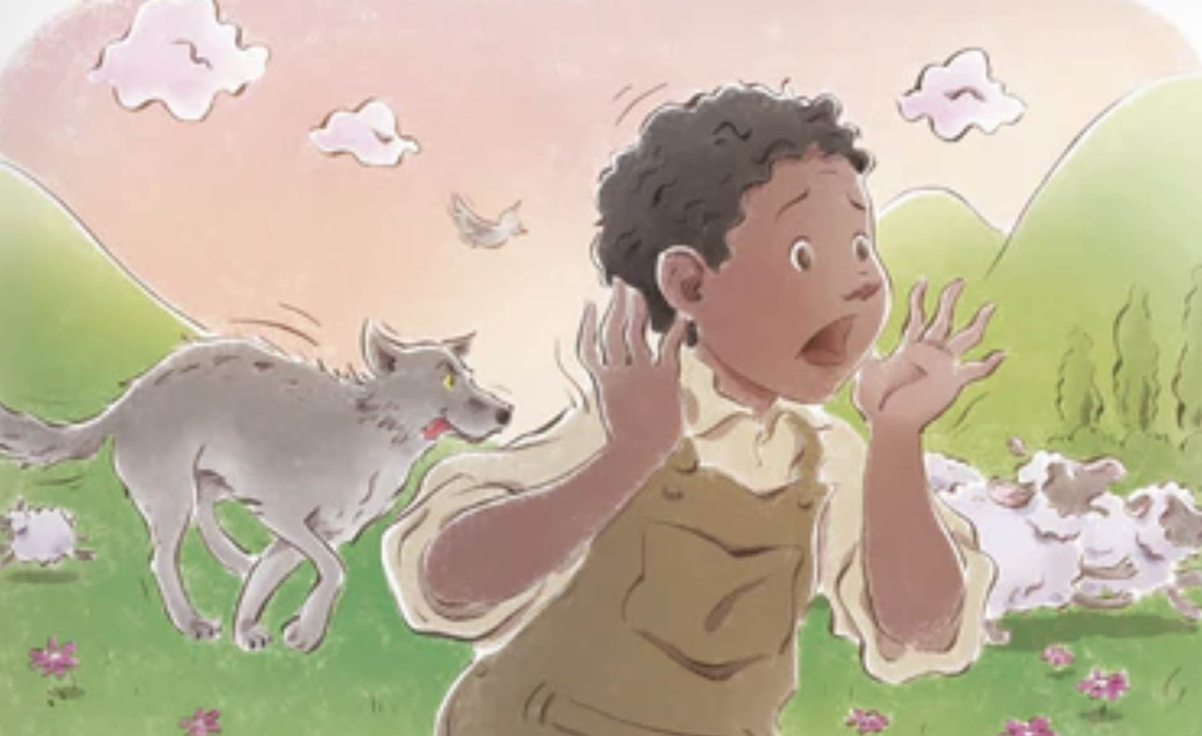
STORYTELLING UNIVERSALITY
[Illustrations: V. Jaskina]
But the boy just grinned and watched them go grumbling down the hill once more.
Later, he saw a REAL wolf prowling about his flock. Alarmed, he leaped to his feet and sang out as loudly as he could, "Wolf! Wolf!" But the villagers thought he was trying to fool them again, and so they didn't come.
At sunset, everyone wondered why the shepherd boy hadn't returned to the village with their sheep. They went up the hill to find the boy. They found him weeping.
"There really was a wolf here! The flock has scattered! I cried out, "Wolf!" Why didn't you come?"
An old man tried to comfort the boy as they walked back to the village. "We'll help you look for the lost sheep in the morning," he said, putting his arm around the youth, "Nobody believes a liar ... "

Slide 23
STORYTELLING UNIVERSALITY
… even when they are telling the truth.

Slide 24
STORYTELLING UNIVERSALITY
… so don’t get caught telling the same lie twice.
Notes:
Thankfully (in this case, at least), it takes a fair amount of effort to overcome the cultural momentum generated by fables and cautionary tales in general, which makes the second interpretation seem off-kilter (and thus wrong) to us: we have heard too many stories over the years to be fooled.

Slide 25
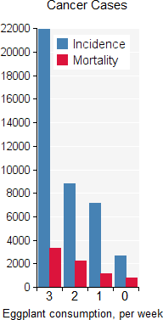
UNIVERSALITY
Ambiguity can also occur in data stories.
What is the take-away here?
Is increased eggplant consumption linked to:
increased cancer incidence, or
diminishing mortality rates?
Notes:
But data stories are a different matter: for the most part, they have not yet penetrated human “extelligence”.⁴⁷ Additionally, whereas the vast majority of us are story-literate (according to the standards of our respective cultures and sub-cultures), we cannot claim to be a data-literate species yet. In practical terms, this means that the “right” interpretation of a data story often escapes us if it is not explicitly presented as such.
Take a look at the following (facetious) chart:
What is the “moral” of the accompanying data story? Is it that increased eggplant consumption is linked to increased cancer incidence, or that is linked to diminishing mortality rates? Is the chart telling us to eat more eggplant, or to cut down on eggplant consumption?⁴⁸

Slide 26
EXERCISES
In your organization, who makes up the audience? Is there only one audience? What are the storytelling goals? Is the storytelling context clear? Constant? Universal?
The Death of the Author: Isaac Asimov once sat anonymously in a class where the topic of discussion was one of his stories. He introduced himself afterwards to the teacher, saying that he had found his interpretation of the story interesting, but it wasn’t really what he had meant at all. The teacher's response was "Just because you wrote it, what makes you think you have the slightest idea what it's about?" How could this come into play when telling stories with data?

Slide 27
EXERCISES
Consider a story titled The Ozone Hole.
give a summary of this story
what is its beginning? it’s end?
what’s the narrative?
who is the audience? the teller?
is it robust? is it the same story now than it was when it was first told?
is it applicable to other situations?

Slide 28
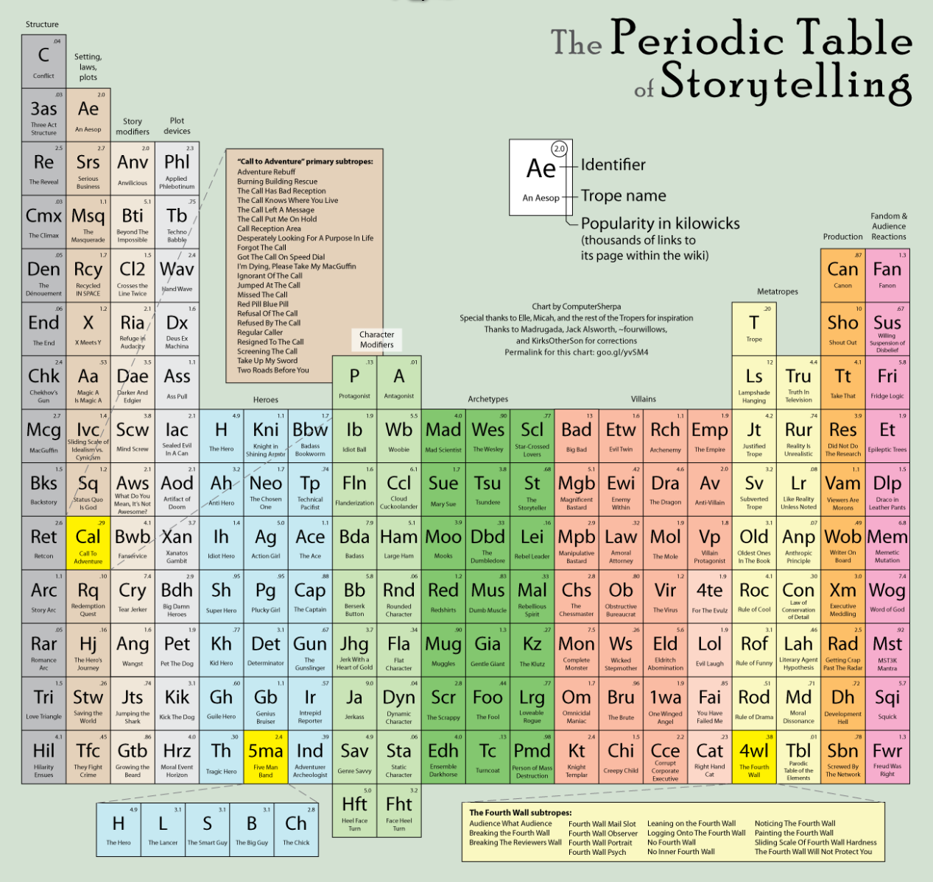
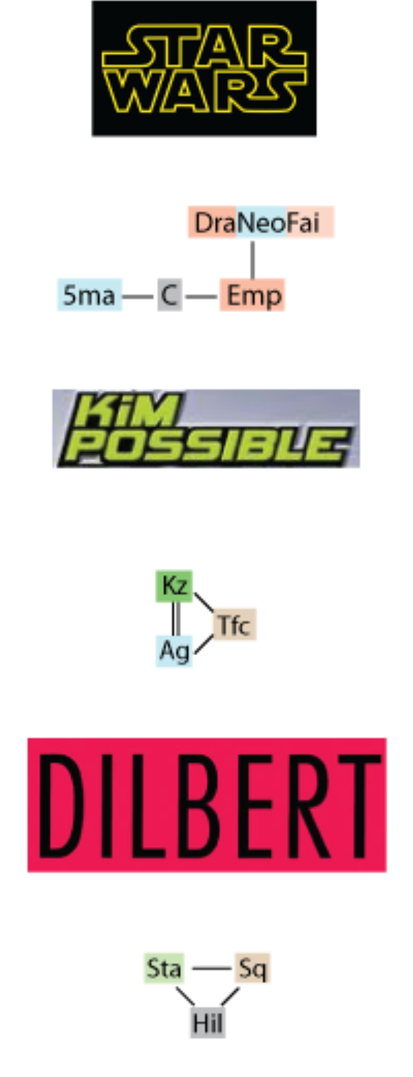
[SonicLover]

Slide 29
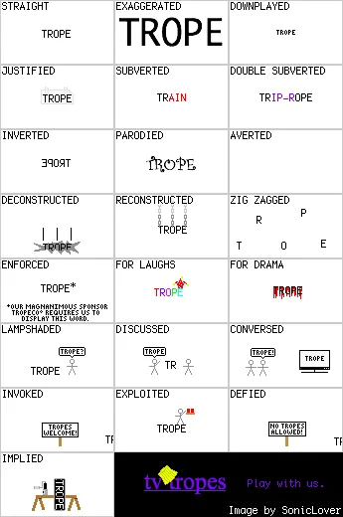
PLAYING WITH TROPES
[tvtropes.org]
Tropes are most useful when they are played with.
Since the conventions are known and understood by the audience, any departure from a trope can be used to convey special information.
In data stories, this often takes the form of looking for what is missing or what differs from expectations.
(We will discuss this further when we talk about the Gestalt principles.)

Slide 30
PLAYING WITH TROPES: THE BUTLER DID IT
[tvtropes.org]
The Butler Did It is one of the most familiar tropes (clichés) of mystery fiction.
The stereotypical example is that a group of individuals are invited to dinner in a wealthy person's house, who ends up being poisoned during the meal.
All the guests had some reason to kill the host, and each is placed in a situation that lets the reader think that they could conceivably be the guilty party.
The murder is debated among the guests; in the climactic summation gathering, the murderer is identified as none other than... the butler, whom no one would have suspected since he's just part of the furniture (obviously an old trope).

Slide 31
PLAYING WITH TROPES: THE BUTLER DID IT
[tvtropes.org]
Played Straight: the butler is the murderer, which genuinely surprises everyone when the fact is revealed.
Justified: the butler decided to get revenge because his sister was killed by his employer.
Inverted: every suspect except the butler was part of the crime.
Backfired: the butler is the murderer, but didn't know that the victim had left him all his riches.
Subverted: the butler did do it, but it was an accidental murder.
Double Subverted: the butler is the prime suspect at the beginning, but then eliminated as a suspect... except he did do it, and the exonerating evidence is false.
Parodied: butlers learn their trade at butler college where they are taught cleaning, cooking, and murdering.
Deconstructed: the butler and his victim were lifelong friends who never got in conflict with one another. It wouldn't make sense for the butler to just murder his best friend for no apparent reason.

Slide 32
PLAYING WITH TROPES: THE BUTLER DID IT
[tvtropes.org]
Reconstructed: the butler didn't kill his best friend out of personal motivation, but for a large sum of money to improve his poor livelihood, and the rest of the story is about figuring out who paid him to murder his friend.
Zig Zagged: the butler did it, but he was under mind control at the time. And it later turns out that the one mind controlling the butler looked exactly like the butler. And then we find out that it was actually his evil twin, who was also a butler. But it turns out it was a conspiracy hatched by the butler and his evil twin, one born out of necessity because the victim was going to do something monstrous.
Averted: a butler appears but no crime occurs.
Enforced: the writer hates butlers, so decides to cast the butler as the killer.
Implied: the detective rules out all the guests one-by-one, but in the end he fails to find the real killer. The astute reader notices he never bothered to investigate the butler.
Logical Extreme: all butlers are in a conspiracy to commit murder.
Exaggerated: all the butlers in the city go on a killing spree, and nobody suspects a thing.
Downplayed: the butler did indeed do it... "it" being leaving the toilet seat up.

Slide 33
PLAYING WITH TROPES: THE BUTLER DID IT
[tvtropes.org]
Played for Laughs: the butler did it, but it took him three hundred and seventeen tries, all of which his master escaped without realizing anything was happening.
Played for Drama: the butler did it, but is quite sympathetic, and the reasons he did it are gone into in great detail.
Played for Horror: the butler killed the family he was working for in sadistic fashion, which he does to every master that doesn't live up to his unreasonably strict standards of how "proper" rich people should act.
Other Variations on a Trope: the murderer isn't called a butler in the story, because the role as we know it doesn't exist in that place or time — but most of their responsibilities or their relationship to their employer-turned-victim are basically the same.
Lampshaded: "So the butler did it! I always wanted to say that."
Invoked: ex-butlers are employed as assassin trainers because of their experience as potential murderers.

Slide 34
PLAYING WITH TROPES: THE BUTLER DID IT
[tvtropes.org]
Exploited: the detective purposely investigates the butler first, because the butler always does it in the mystery books he reads.
Discussed: "Unlike what you may read in detective stories, the butler is an unlikely suspect in any murder investigation of this sort."
Untwisted: the butler is shown early on as the suspect with the flimsiest alibi, like a typical red herring with a big secret, but after a series of twists and turns the detective reveals to everyone's surprise that he was the murderer after all.
Defied: "We have to lock all the butlers up before they can kill!"
Conversed: "These murder mysteries are too predictable. The butler always does it."
Unparodied: there is an evil butler suit that brainwashes the wearer into committing murder. Someone dumb puts the suit on and, next thing he knows, he has committed 100 murders. He then ends up serving a longer-than-life sentence.

Slide 35

[Robinah Babirye, This Is Just The Beginning, The Moth]

Slide 36
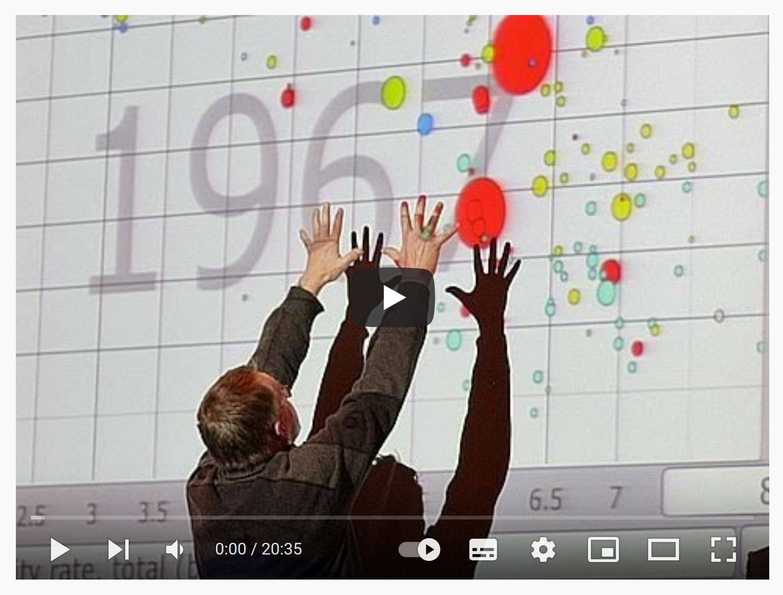
[Hans Rosling, The Best Stats You’ve Ever Seen, TED Talk]

Slide 37
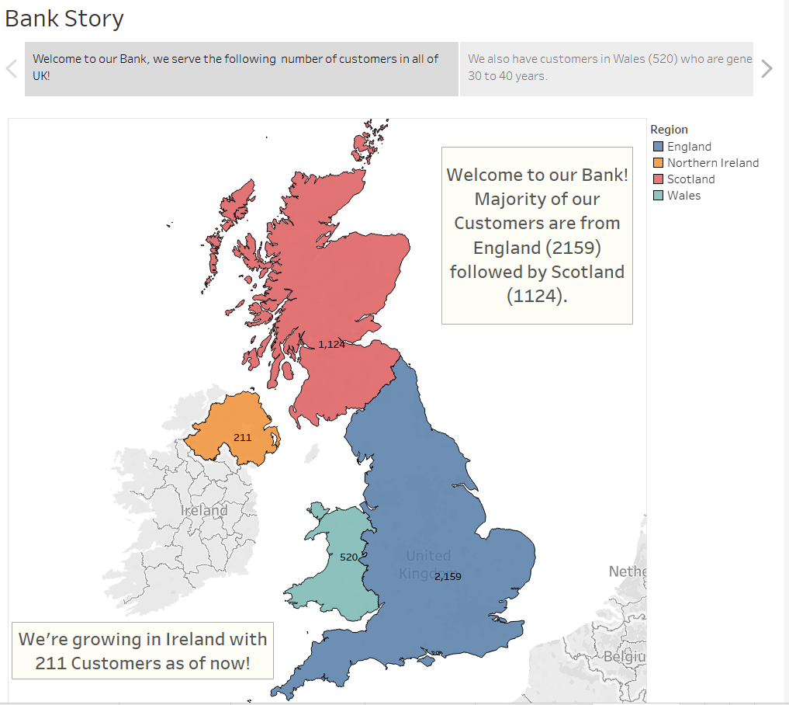
[Y. Gupta]

Slide 38
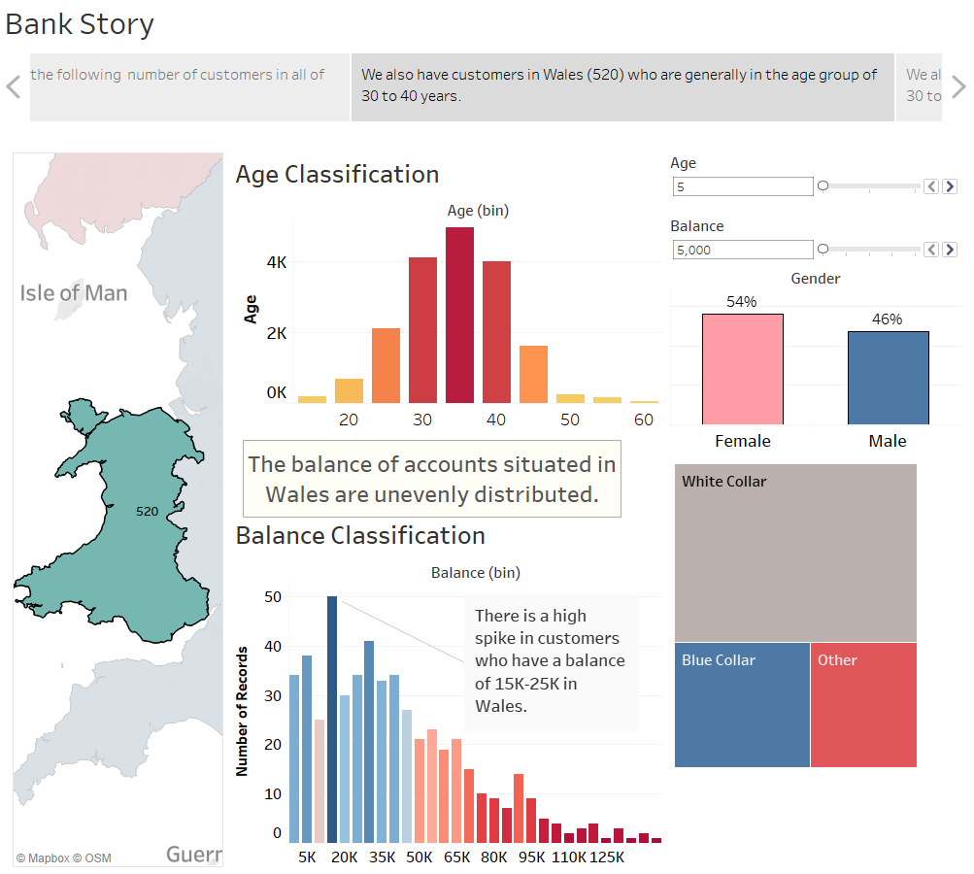
[Y. Gupta]

Slide 39

[Y. Gupta]

Slide 40

[Y. Gupta]

Slide 41

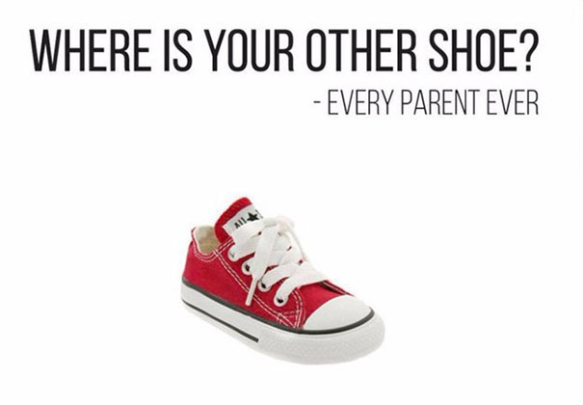

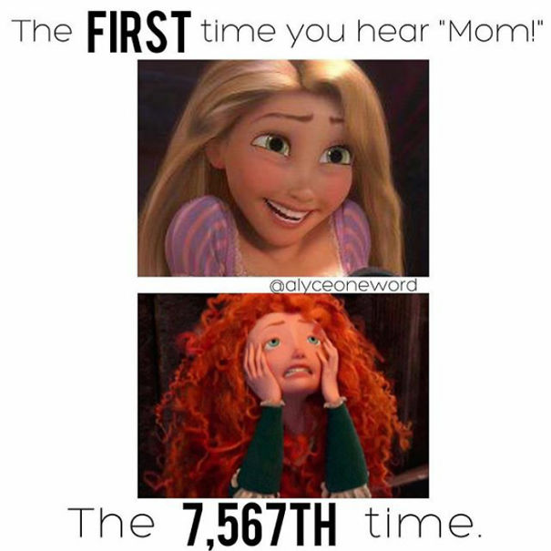
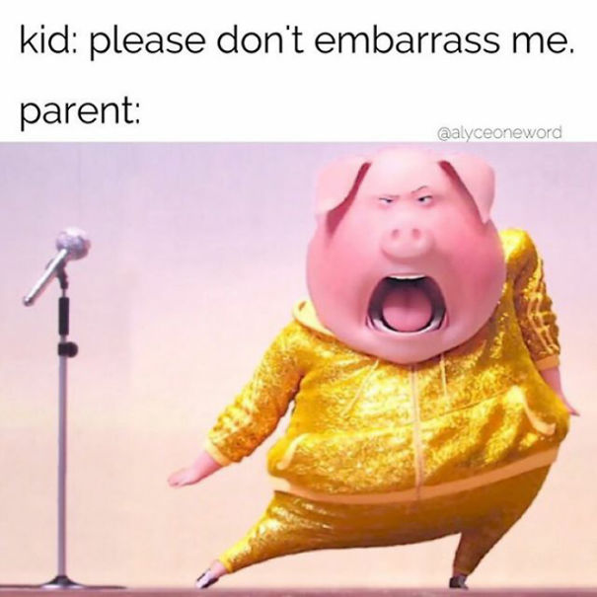
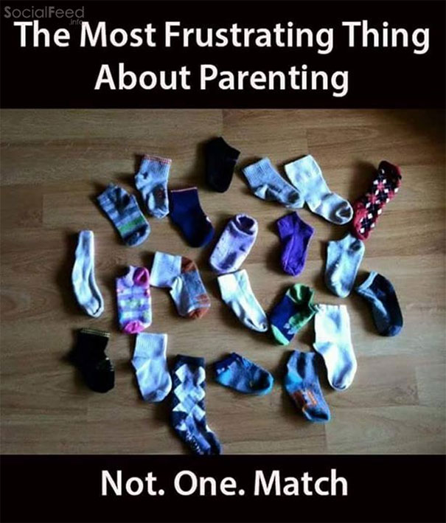

Slide 42
EXERCISES
How would you fix the following stories, using the concepts presented in this section?
One day I woke up. I went outside and there was weather. I came back inside and did things.
Once upon a time there was a hero. She left on an adventure and fought a giant dragon. Then she fought another giant dragon. Then she fought another giant dragon. Then she fought another dragon. Then she went home, victorious.
The rain was bucketing down in immense impenetrable sheets of torrential freezing water. “Oh woe is me!”, the brave but sobbing child screamed. How shall I ever manage to dash as quickly as humanly possible into the terrible wreck of an ancient schoobus without completely mangling my magnificent hair. Indeed, the desolate child failed. She was the laughingstock of all of the pompous fools on the school bus.

Slide 43
HOW TO TELL A STORY
PART I – STORIES AND STORYTELLING

Slide 44
MINING FOR CONTENT
[Based on How to Tell a Story, The Moth]
Stories are born when storytellers decide to tell them (persuasion, entertainment, …).
Where do story ideas come from?
memories
data and analysis
anything else?
Think of moments when conscious decisions were made: what happened as a result? How is the story impacting you? Your organization? Your audience?

Slide 45
MINING FOR CONTENT
[Based on How to Tell a Story, The Moth]
What triggered the story?
internal act
external factors
Think of moments when things went wrong:
recovery
lessons learned
Trauma, struggle, challenges, difficulties define the story context, not the story itself. Stories need to go beyond “a bad thing happened”.

Slide 46
STORY FOUNDATION
[Based on How to Tell a Story, The Moth]
What is at stake? What do people/organizations/countries/NHL teams/etc. stand to lose or to gain as a result? Stakes tell audiences why they should care.
Is the story at-best an anecdote? Stories have messages and impact, anecdotes usually lack depth (but they can form the basis of a story).
What is the arc of the story? How are things transformed in the story? How must things be done differently after the transformation? Are the changes permanent?
What is the story ultimately about? Can it be distilled down to 1 or 2 sentences (focus/clarity)? Is it the only story that can be told for the events/memories/data?

Slide 47
STORY MATERIALS
[Based on How to Tell a Story, The Moth]
Identify the important information needed to build the story arc
create a bulleted list of narrative stepping stones
some become scenes/chart elements, some summaries, some are discarded
What is the story building up to? How will it resolve?
What role (if any) should hindsight play in the story’s telling?

Slide 48
STORY MATERIALS
[Based on How to Tell a Story, The Moth]
Avoid detail overload
misleading and/or irrelevant tidbits
too many dates, colours, characters, shapes, etc.
When in doubt, return to distilled story & determine if the details support the story
Does your audience have the required backstory to understand the message? Does it need to be weaved into the story?
Does the story arc land? (tsarina of common sense)

Slide 49
BEGINNINGS AND ENDINGS
[Based on How to Tell a Story, The Moth]
Chose the beginning and closing points of the story carefully.
Beginnings can be in media res, if necessary.
Endings that leave the audience wondering ‘what was that about?’ are unsatisfying.
Endings that come to a definite stop are satisfying.
No need to be coy: make the message clear and don’t make the audience guess.

Slide 50
SHARING THE STORY
[Based on How to Tell a Story, The Moth]
First passes are long, convoluted, complicated, but that’s ok!
Share the story with your tsarina of common sense, and decide if the story needs to be restructured:
are there redundancies to remove?
are there too many details, causing confusion?
are there too few details, leading to ambiguity?
is the message clear?
are there competing (contradictory?) interpretations/insights to be drawn from the story?

Slide 51
COMMUNICATION
Communication involves our senses: anything that conveys the message is in play.
Does the communication mode have an impact on the type of story that can be told? On how they are built? On the messages that can be conveyed?
Stories can be communicated:
orally (in person, conversation, play, radio, etc.)
with text (newspaper, books, tweets, etc.)
visually (graphic novels, infographics, posters, etc.)
with charts (dashboards, visualizations, etc.)
in combination (movies, memes, etc.)

Slide 52
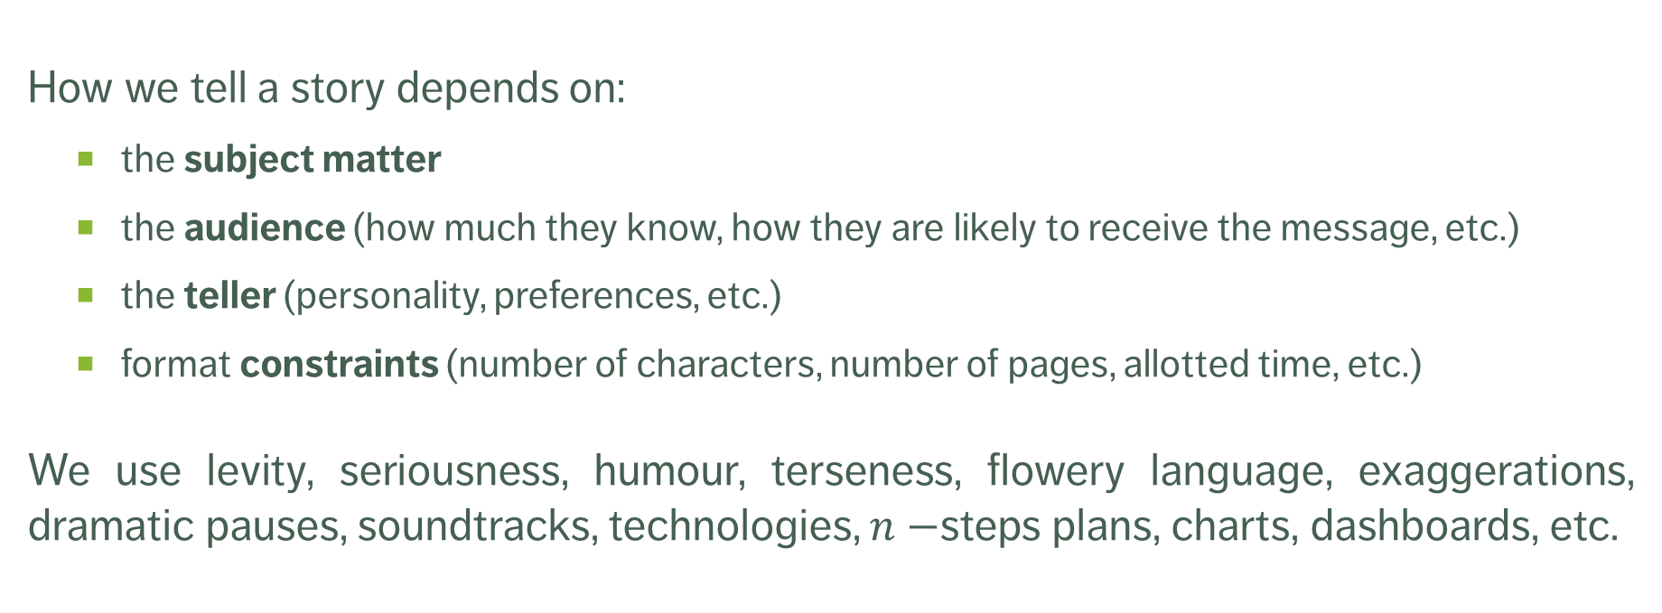
HOW TO TELL A STORY
How we tell a story depends on:
the subject matter
the audience (how much they know, how they are likely to receive the message, etc.)
the teller (personality, preferences, etc.)
format constraints (number of characters, number of pages, allotted time, etc.)
We use levity, seriousness, humour, terseness, flowery language, exaggerations, dramatic pauses, soundtracks, technologies, $n−$steps plans, charts, dashboards, etc.

Slide 53
HOW TO TELL A STORY
Some storytelling formats have themselves become stories:
infographics
tweets and other social media products
memes
TED Talks
The Moth
news report
rap battles
etc.

Slide 54
HOW NOT TO TELL A STORY
We suggest avoiding certain tropes:
audience-alienating premise
author filibuster/tract
emphasize EVERYTHING!!!
redundant tautology
viewers are geniuses
But in truth, what matters is getting the message across. Everything that helps in that endeavour is allowable, everything that hinders that goal is not recommended (get an outsider’s perspective!).

Slide 55
HOW TO TELL A STORY
Even to the point of parody…

Slide 56
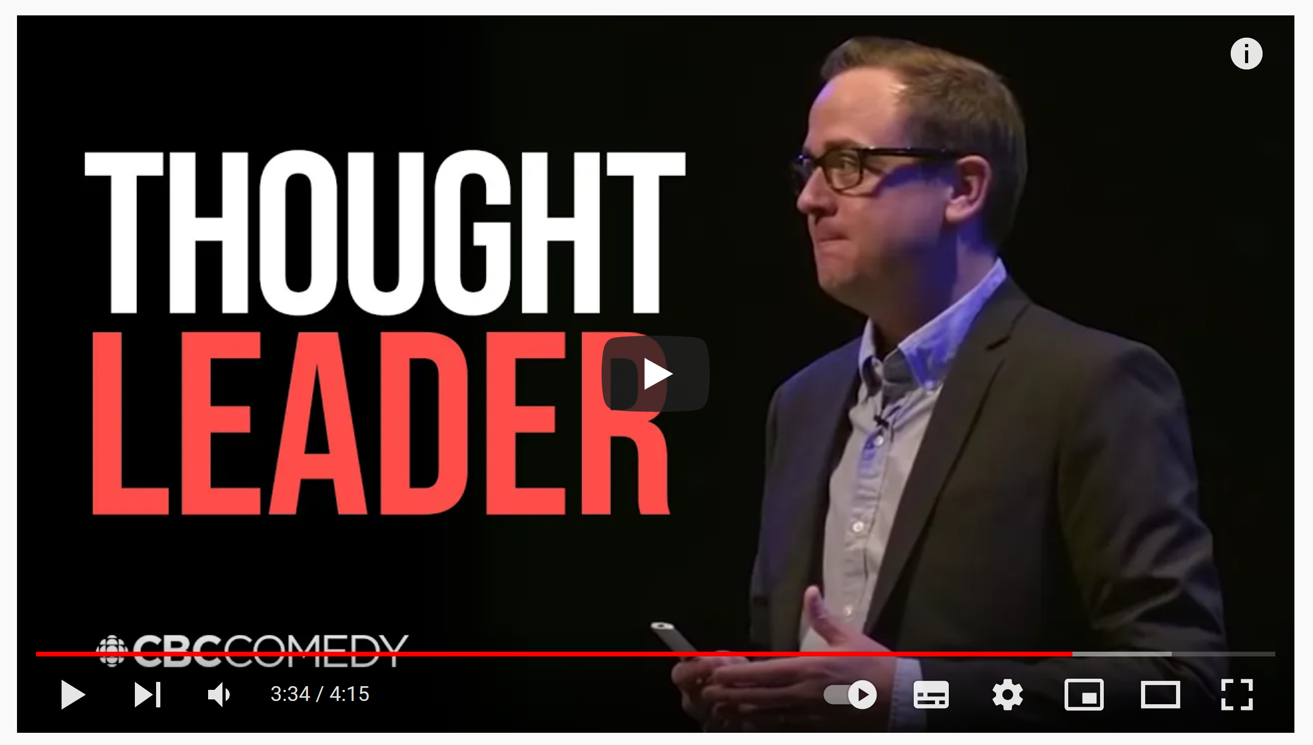
[Thought Leader, This and That, CBC Radio]

Slide 57
EXERCISES
Start by taking a few moments to think of a very short story you can tell (context, events, outcome).
Pair up: one of you will be the storyteller, the other person is the audience.
Pair up again: the storytellers should become the audience for someone who was an audience of another group in part a.
Pair up a third time and repeat parts a. and b., with different teammates if possible.
How did the story change the second time you told it? What made you change it?

Slide 58
WORDS AND IMAGES
[based on an idea from S. McCloud, Making Comics]
A picture is worth a thousand words (compare with: a picture is worth 1000 words).
Words bring an unparalleled level of specificity. There is no image so vague that words cannot lock it into a desired meaning.
Some specific concepts and names can only be clearly expressed through words.
Notes:
It is said that a picture is worth a thousand words. How so? “Words bring an unparalleled level of specificity to all kinds of situations: there is no image so vague that words cannot lock it into a desired meaning.
McCloud presents the following example [35]:

Slide 59
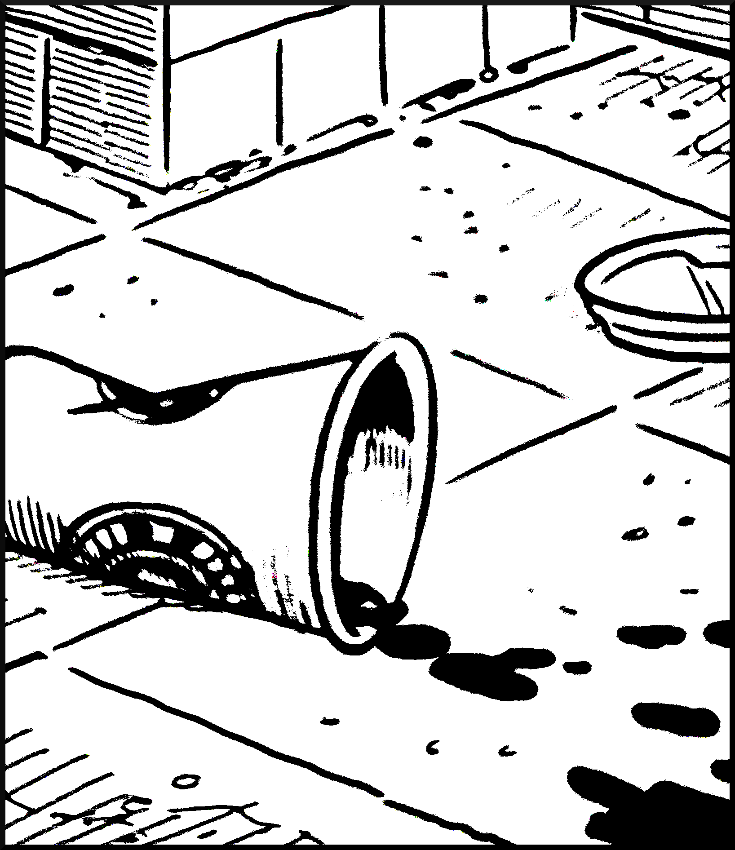
[S. McCloud, Making Comics]
Notes:
What are we seeing here? A coffee cup, certainly. Thrown to the ground by an apathetic city dweller who could not be bothered to place it for a refuse bin? Or perhaps the coffee was too hot and scalded a customer, who dropped it to the ground in agony? Or any of a variety of other scenarios?

Slide 60
[S. McCloud, Making Comics]
“On the bright side, I got my caffeine. On the not-so-bright side, we got mugged on the way home.”
Notes:
Notice how the caption below collapses all interpretation to a single one, leaving no doubt as to what it is that the image is conveying.
Figure 3.45: On the bright side, I got my caffeine. On the not-so-bright side, we got mugged on the way home. [35]

Slide 61
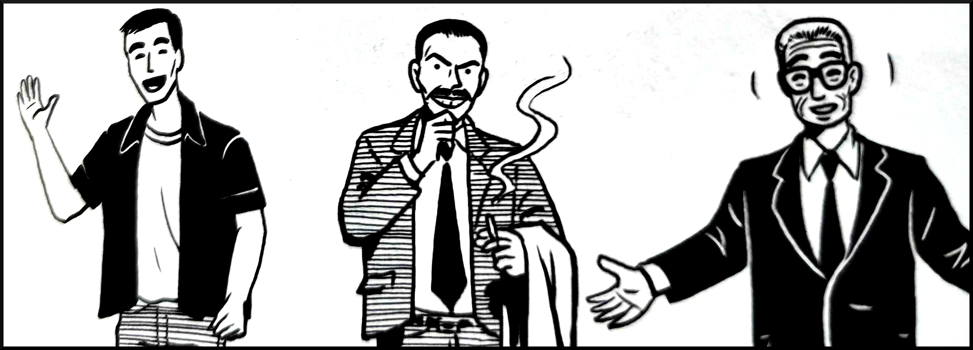
[S. McCloud, Making Comics]
Notes:
Additionally, some specific concepts and names can only be clearly expressed through words. Who could ever correctly guess what is going on in the following image without the caption?

Slide 62
[S. McCloud, Making Comics]
“It’s Kelly Donovan, twin brother of the Xander actor on Buffy the Vampire Slayer, plus Humphrey Bogart wearing a Freddy Mercury mask, and a robot duplicate of former U.N. Secretary General Boutros Boutros-Ghali!”
Notes:
Figure 3.46: Look! It’s Kelly Donovan, twin brother of the guy who played Xander on Buffy the Vampire Slayer, plus Humprey Bogart wearing a Freddy Mercury mask, and a robot duplicate of former U.N. Secretary-General Boutros Boutros-Ghali! [35]
Data story audiences are not always privy to the ins-and-outs of the analytical process that lead to a chart; what may appear obvious to the analysts may be opaque to stakeholders. It is preferable to err on the side of caution and use text wisely, leaving no room for ambiguity.

